Slide 1
Process/Thread Basics
CSSE332 Operating System

Slide 2
Outline
What is a process and thread?
Process data struct – PCB (Process Control Block)
Process state and transition
Intro to User-space Thread Lab 2

Slide 3
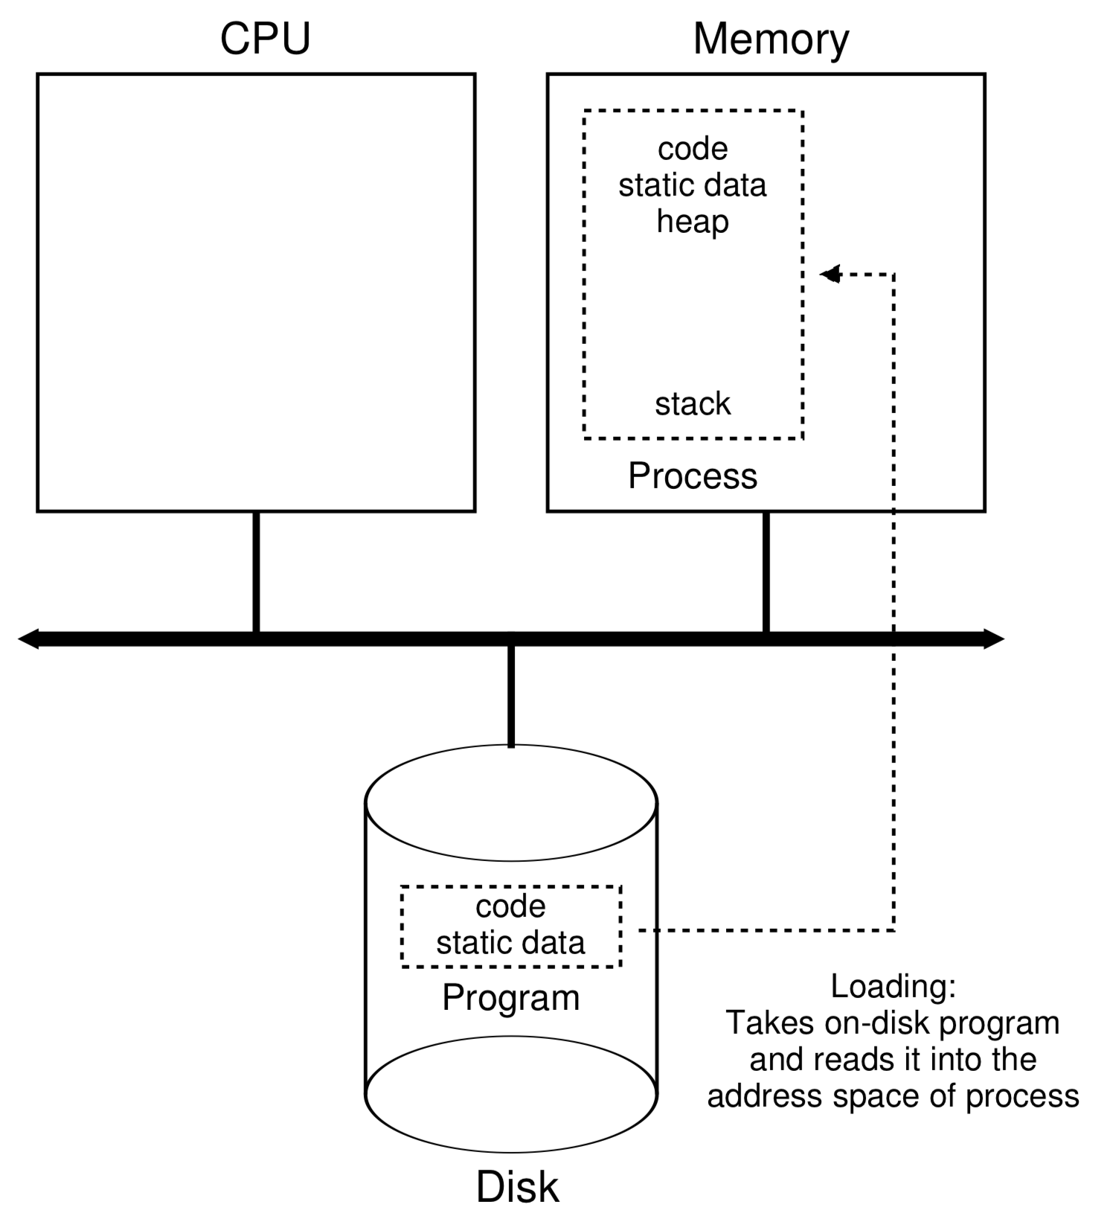

A process is a running program
Double click the icon

Slide 4
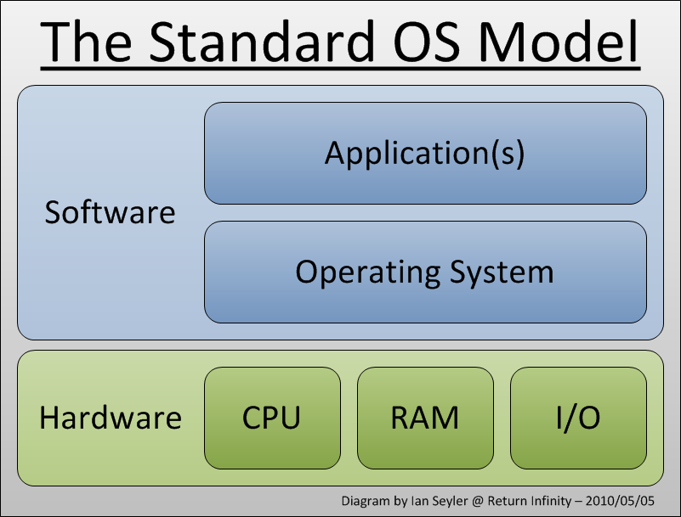

Fast Review: What is Operating System again?
It is a program:
Its job is to manage other programs.
It is the first program to run in a computer.
It directly controls all hardware resources (CPU, memory).
Every other programs need to request resources thru OS.
My quirky OS analogy: Immortal Joe is the OS in Mad Max 4 : )

Slide 5
Thread is like a “subprocess”
Process v.s. Thread

Slide 6
How to switch between 2 “threads” (swapcontext)
Update program counter – what is next code run.
Update the stack pointer – where is my own stack.
Store the current registers into memory – remember what’s in the current context now
Restore the saved state of the computation registers – restore the previous context.
How to switch between 2 “processes”?

Slide 7
Process: Data Structure
In Linux, there is a struct task_struct that represents each process:
Each process has a process control block (aka struct task_struct) that stores its information
Process list is a linked list that keeps track of all the processes
I planed to show you the source code of struct task_struct, but…..
The definition of the struct includes 634 lines of code.
Adapted from Peter Bui @ND

Slide 8
Process Control Block
Process state
Program counter
CPU registers
CPU scheduling information
Memory-management information
Accounting information
I/O status information
**Many modern OS’s expanded process concept to support multiple threads, so PCB can also include threads info.
More details: https://en.wikipedia.org/wiki/Process_control_block

Slide 9
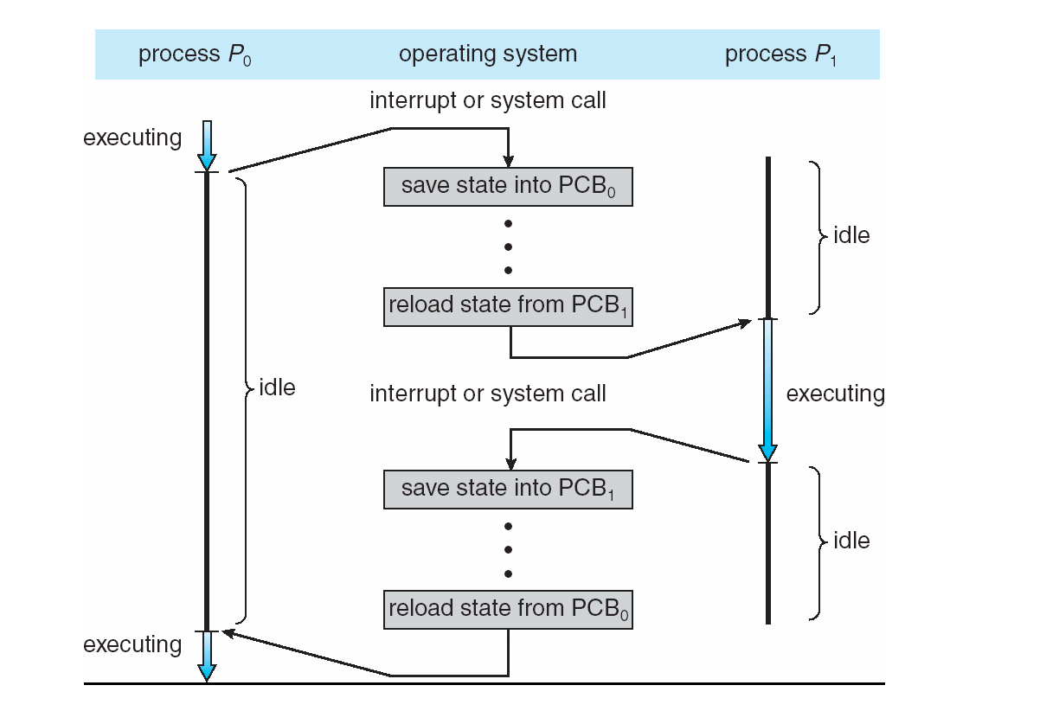
CPU Context Switch From Process to Process
Context-switch time is overhead; the system does no useful work while switching.
Time for context switch dependent on hardware support.
Notes:
Discuss here

Slide 10
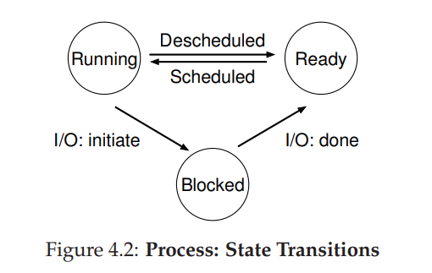
Process: States
A live process can be in different states:
Notes:
Use the functions in lab 1 to illustration

Slide 11
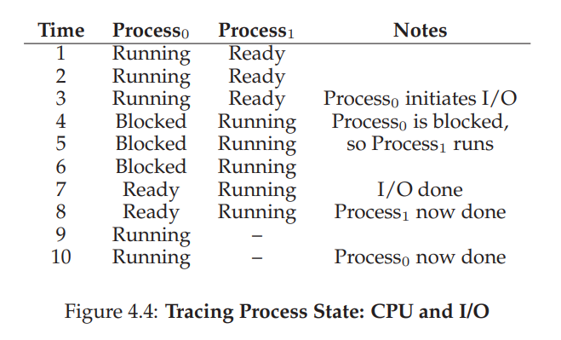
Process: State transition example

Slide 12
Link to User-space Thread Labs
Swapconext helps change “states” for different threads

Slide 13
Link to User-space Thread Labs (cont.)
User-space thread lab 1

Slide 14
Link to User-space Thread Labs(cont.)
User-space thread lab 2

Slide 15
What’s coming in the first third
Signals and interrupts – how we can disrupt normal program execution to allow the illusion of concurrency
Process creation (fork), process communication
Filesystems (sort of a standalone thing)

